Slide 1



EagleSat-I
Refining Orbit Propagation Model of Small Satellites using Cube Satellite and Amateur Radio
Deborah Jackson
Embry-Riddle Aeronautical University Aerospace Engineering, Freshman
Presentation for
AZ/NASA Space Grant Symposium
April 21-22, 2017

Slide 2
Overview
Mission Statement
Satellite Structure
Orbital Data Format
Amateur Radio Theory
EagleSat-1 Radio Setup
Predictions

Slide 3
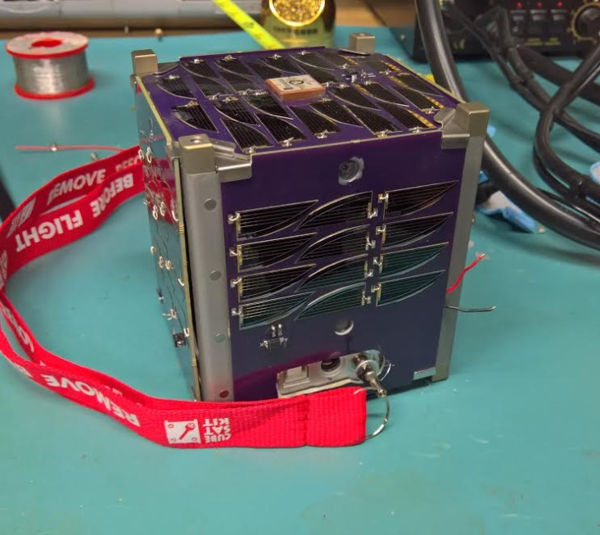
Mission Statement
Mission: analyze orbit propagations for cube satellite orbital decay
  Orbital decay difficult to predict
  Less accurate further in future
  Pave way for future space missions
My job: Communications
  Collect data via amateur (ham) radio
  Build orbital decay model from data
Notes:
Launch: August 29, 2017 with ElaNa14

Slide 4
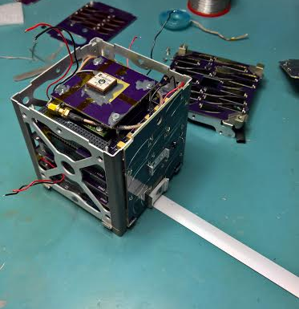
Structure
GPS
Radio Module
Wire burner
Super Capacitor Power Bank
Motherboard (OBC)

Slide 5
Orbital Data: RMC String
$GPRMC,123519,A,4807.038,N,01131.000,E,022.4,084.4,230394,003.1,W*6A
Recommended Minimum sentence C
Status A = active
V = void
Track angle (degrees True)
Magnetic Variation
Longitude 11 deg 31.000’ E
Fix taken at 12:35:19 UTC
Latitude 48 deg 07.038’ N
Date: March 23, 1994
Checksum data
Speed over ground (Knots)

Slide 6
Orbital Data: GGA String
$GPGGA,123519,4807.038,N,01131.000,E,1,08,0.9,545.4,M,46.9,M,,*47
Recommended Minimum sentence C
Longitude 11 deg 31.000’ E
Checksum data
Latitude 48 deg 07.038’ N
Fix Quality
Horizontal dilution of position
Height of geoid (mean sea level) above WGS84 ellipsoid
Fix taken at 12:35:19 UTC
Number of satellites tracked
Fix quality: 0 = invalid
1 = GPS fix (SPS)
2 = DGPS fix
3 = PPS fix
4 = Real Time Kinematic
5 = Float RTK
6 = estimated (dead reckoning)
7 = Manual input mode
8 = Simulation mode
time in seconds since last DGPS update & DGPS ID
Altitude (Meters above mean sea level)

Slide 7
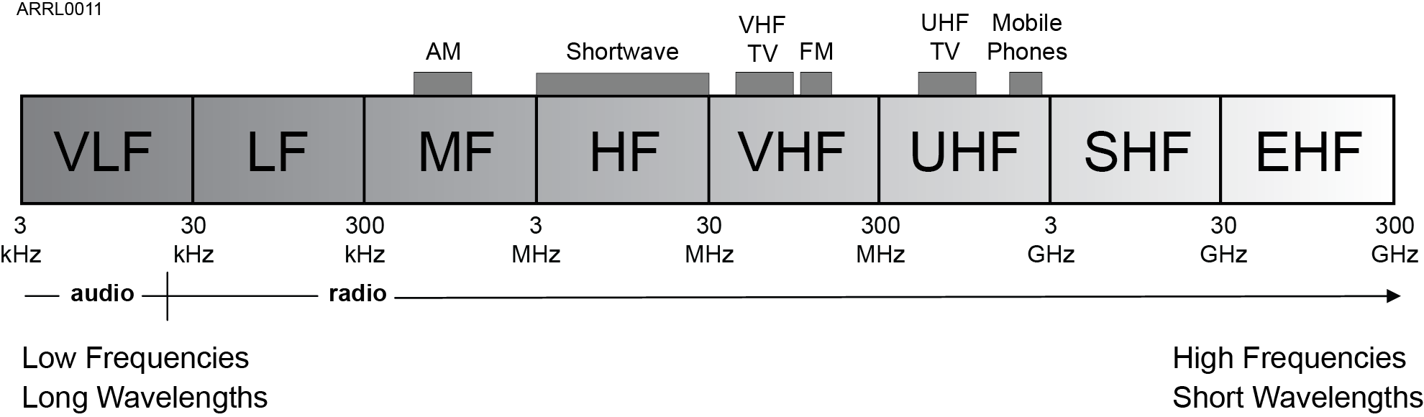
Background: Ham Radio
Electromagnetic waves
Transmitting: signal “vibrates” antenna electrons at freq
Receiving: wave “vibrates” antenna electrons in sync (freq)
From ARRL presentation Module 2-6th Ed-V2.1
Notes:
Made of electric and magnetic energy fields
Speed of light
Transmissions vibrates electrons to transfer energy from signal to electro waves
Receiving vibrates electrons so in sync to transfer energy from wave to signal

Slide 8
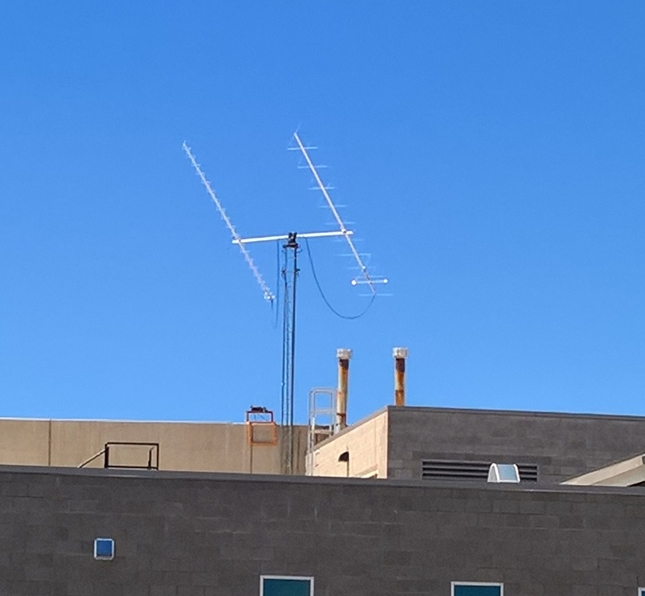
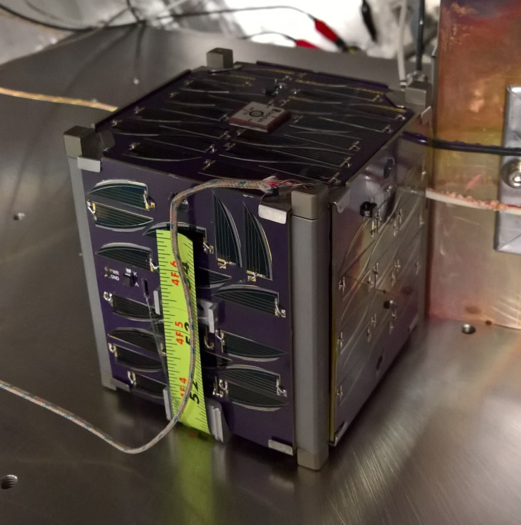
Our Setup
Ground Antenna: Yagi (23 element)
Satellite Antenna: Monopole
Frequency: 437.645 MHz
Notes:
Antenna: steel, 17.8 cm long, 25 degrees from top of structure
Talk about AX.25 packages

Slide 9
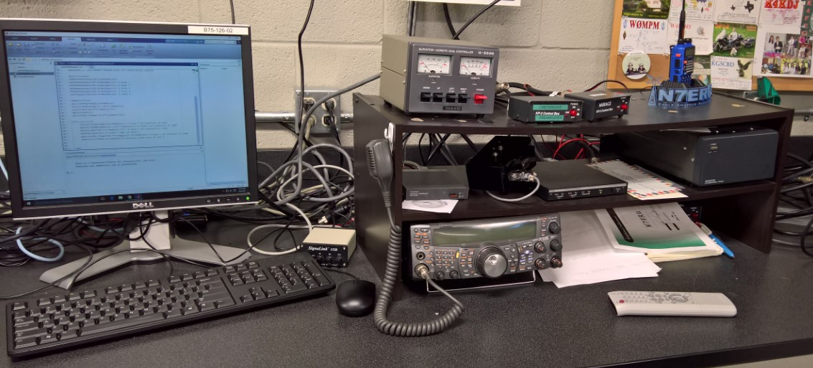
Our Setup, cont’d
Notes:
Antenna: steel, 17.8 cm long, 25 degrees from top of structure

Slide 10
Our Setup: Transmitting
Controller
Elevator
Computer
Antenna
TNC
Radio
Notes:
Antenna: steel, 17.8 cm long, 25 degrees from top of structure

Slide 11
Our Setup: Receiving
Antenna
Pre-amp
Radio
TNC
Computer
Notes:
Antenna: steel, 17.8 cm long, 25 degrees from top of structure

Slide 12
Predictions
Estimated Life span: 2-5 years
GPS data will analyze propagation models for small satellites
  Observe
  Propagate for future
  Observe
  Present discrepancies

Slide 13





Acknowledgements
Dr. Gary Yale
Delbert Conn
Sean Akana
EagleSat-1 Team
Embry-Riddle Aeronautical University
NASA Arizona Space Grant Consortium
Wood & Douglas (UK)
Ignite Undergraduate Research
Arizona Near Space Research

Slide 14
Questions
Please feel free to contact me:
Deborah Jackson
(503) 913-7872
JACKSD40@my.erau.edu

